Slide 1
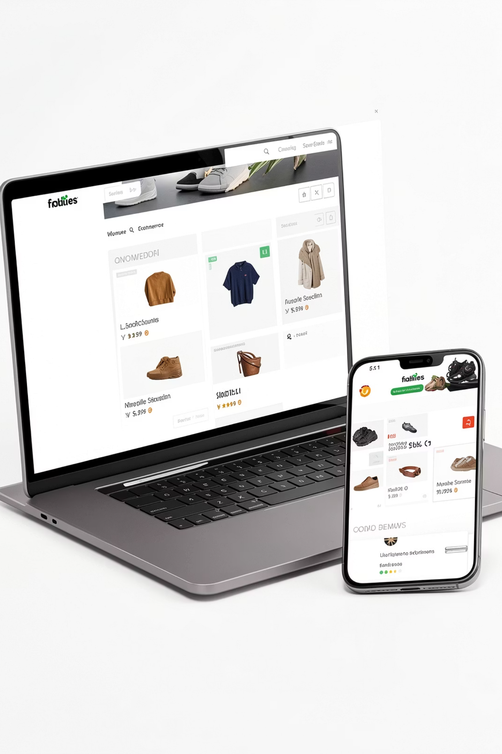
E-Commerce Platform with Admin Panel
Built with Next.js, Node.js, Express.js & MongoDB
MCA PROJECT
ACADEMIC YEAR 2025-26

Slide 2

Project Overview
The Platform
A full-stack web-based online shopping platform with a dedicated admin dashboard.
Core Goals
Seamless browsing, secure authentication, efficient order management, and full admin control.

Slide 3
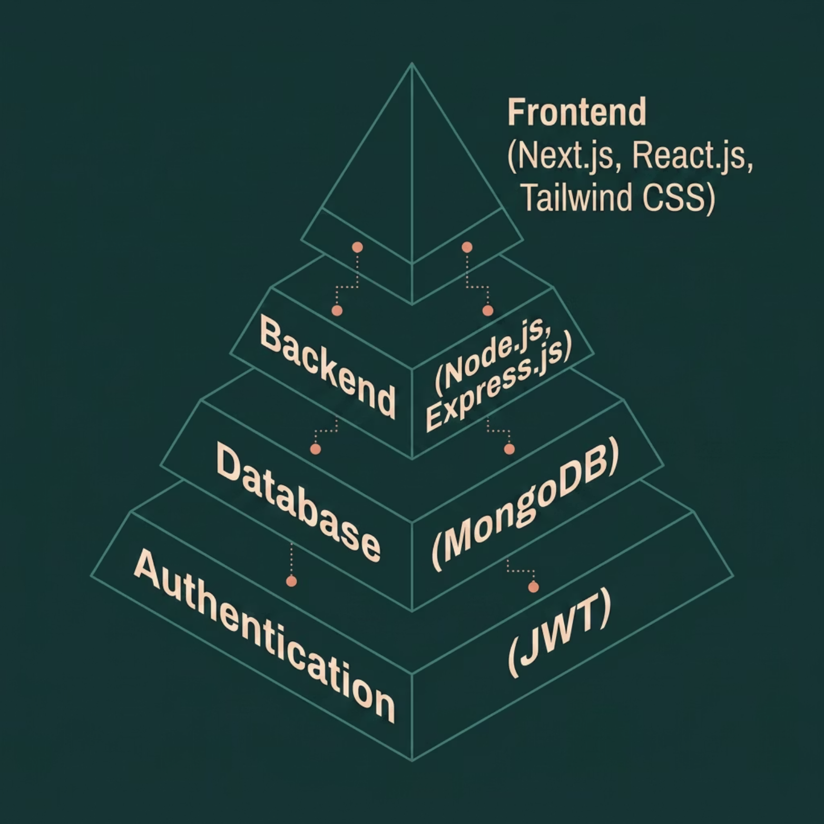

Technology Stack
Why This Stack?
Next.js — SSR & routing
React.js — component UI
Tailwind CSS — utility-first styling
Node.js + Express — RESTful API layer
MongoDB — flexible document storage
JWT — stateless auth tokens

Slide 4

System Architecture
User Browser
Next.js Frontend
Express API
MongoDB Database
A clean client-server model — Next.js handles rendering, Express exposes REST APIs, and MongoDB persists all data.

Slide 5
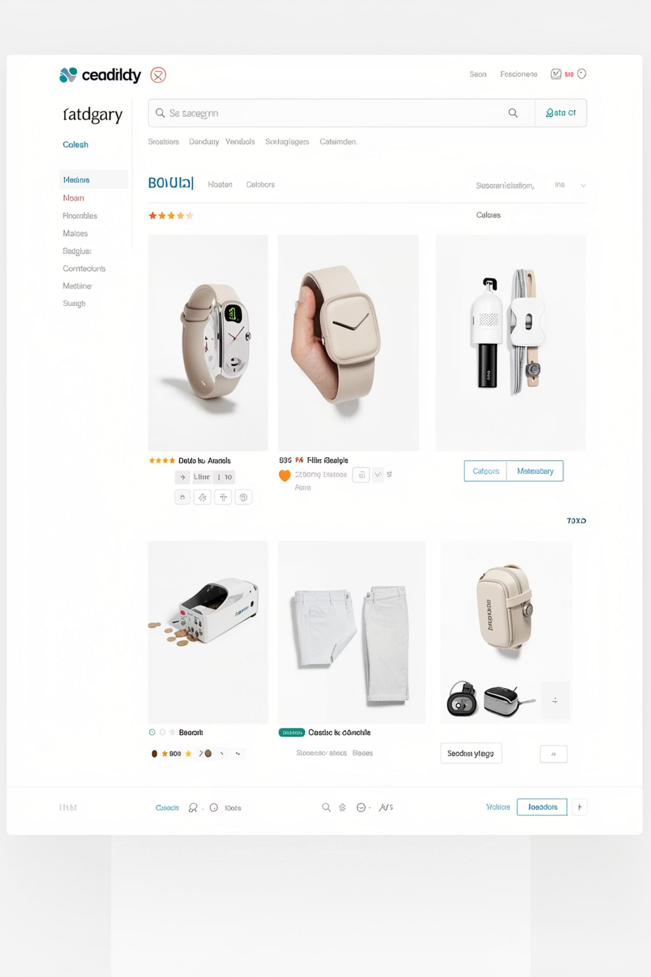

User Features
Registration & Login
Secure sign-up with JWT-based sessions.
Search & Filtering
Find products by name, category, or price range.
Cart & Checkout
Add to cart, review, and place orders seamlessly.
Order History
Track past orders and current status.

Slide 6
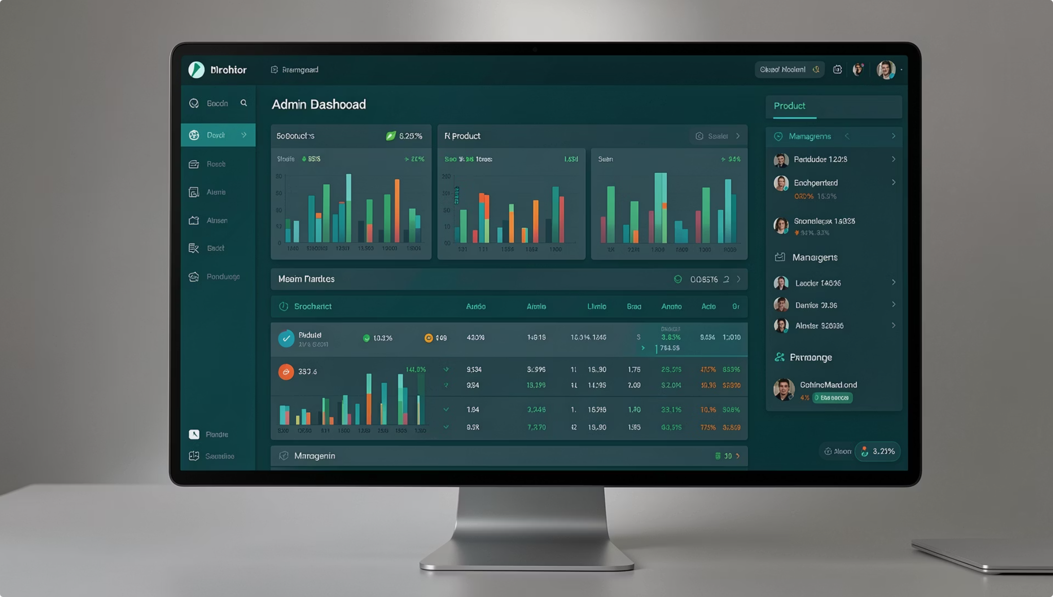
Admin Panel Features
Product Management
Full CRUD — add, edit, delete products.
Category & User Control
Organize catalog; manage user accounts.
Order Tracking
Monitor and update order statuses.
Sales Analytics
Visual insights into revenue and trends.

Slide 7
Database & Security
MongoDB Collections
Security Measures
JWT — stateless authentication
Password hashing — bcrypt encryption
Protected routes — middleware guards
Input validation — sanitization layer
Users
Products
Orders
Categories

Slide 8


Conclusion & Future Scope
Project Benefits
Fast, responsive, scalable — with intuitive admin control.
What's Next
Payment gateway, AI recommendations, wishlist & mobile app.
Thank you. Questions & Answers welcome.

